Slide 1
Unified Mentor Data Science Internship Program
Project 1 - Supply Chain Management Dashboard

Slide 2

Strategic Insights into Supply Chain Management

Slide 3

INTRODUCTION
This presentation provides an in-depth analysis of our sales data, focusing on crucial metrics such as Revenue trends, Defect rates, and other business-critical insights. By examining product performance, customer demographics, supplier efficiency, and shipping carriers, we aim to answer key questions that impact business growth and operational efficiency. This data-driven approach highlights opportunities for improvement and supports strategic decision-making.

Slide 4
Quick look into the Data
Before exploring detailed insights and answering key business questions, let’s first review some key metrics such as total sales, total revenue, top products, regional sales and customer demographics. This high-level overview will provide a snapshot of the current business performance.
Following this summary, we will dive deeper into each visual representation to extract actionable insights that can support business growth and profit maximization.

Slide 5
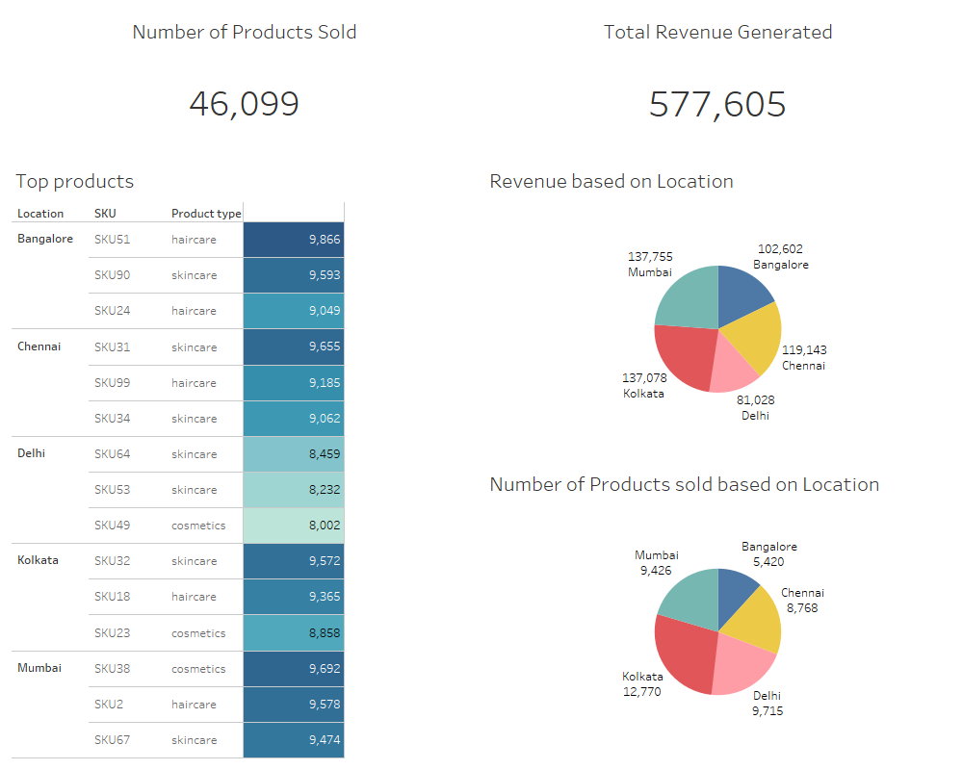

Slide 6
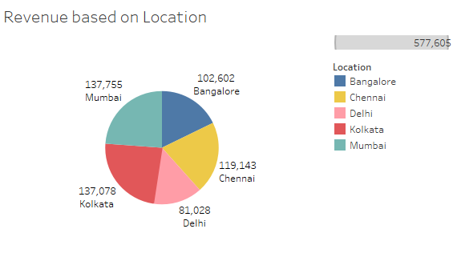
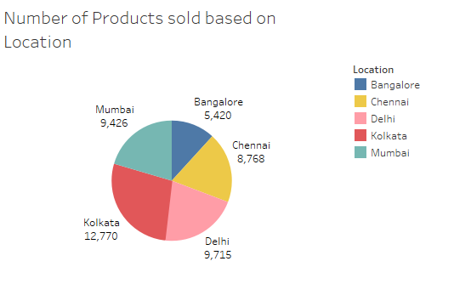
Sales Distribution by location
These pie charts provide a clear overview of the locations generating the highest sales and revenue. It is evident that Kolkata leads in both sales and revenue. Additionally, while Bangalore has comparatively lower product sales, it is generating nearly the same revenue as other cities.

Slide 7
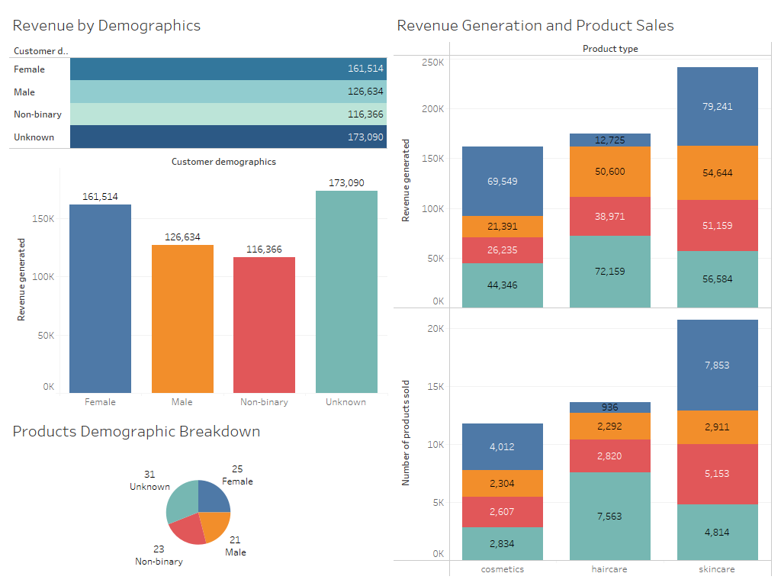

Slide 8
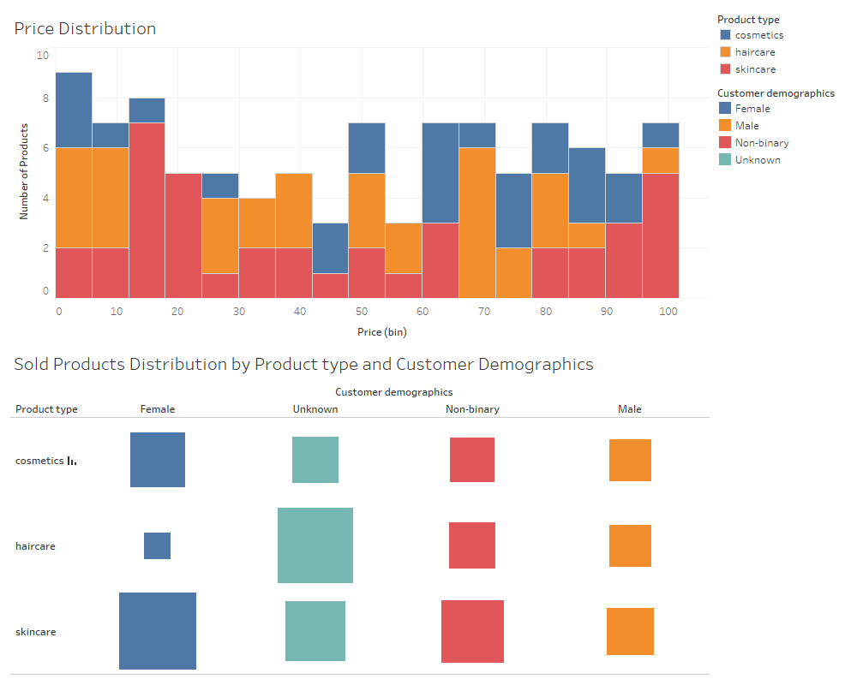

Slide 9
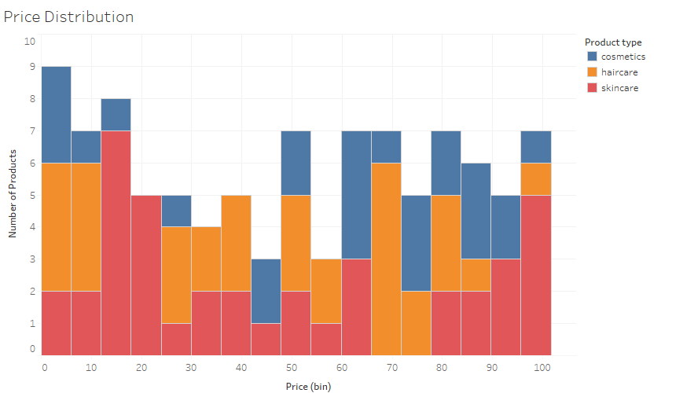
This visual shows the price distribution of the products across different product type.
Cosmetics products are mostly in the range of 45-100 with a few products in the 0-15 price range too.
Haircare products are almost evenly distributed throughout. However there are fewer products costlier than 85
Most of the skincare products are in the price range of 0-25 and 80-100. However there are a few products in the range of 25-65 too. This suggests that skincare products prices are more diverse than the other two.

Slide 10
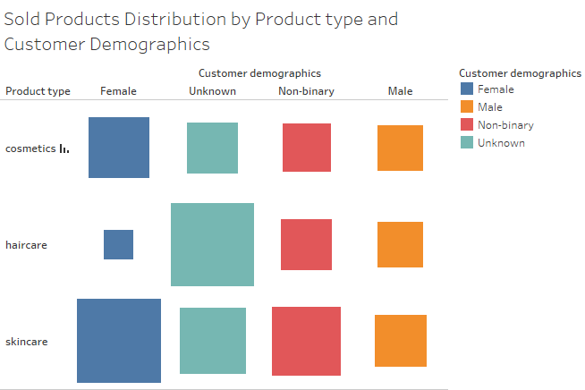
This visual shows that what are the target groups for different products.
The sales of cosmetic products are nearly uniform across all customer demographics, with a slight increase for female customers.
The sales of haircare products is the most for gender neutral products.
The sales of skincare products are nearly uniform across all customer demographics, with a slight increase for female customers.

Slide 11
Understanding Business Problems
Now that we’ve reviewed the data summary, it's time to dive deeper into the analysis and extract meaningful insights.
Rather than searching for insights randomly, a more effective approach is to outline key questions first, then use the data to answer them.
This method will help us stay focused, ensuring we understand what information we need from the data and where we are headed.

Slide 12
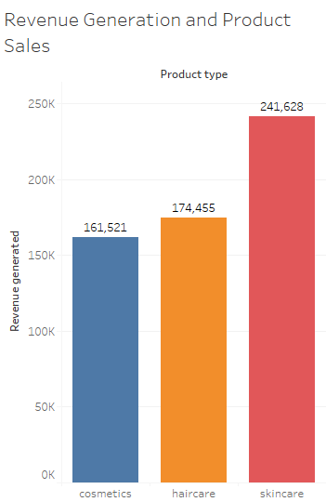
Critical Questions from the Sales Analysis
Which Product type generates the highest revenue and what are the top products from each product type?
The following bar graph illustrates that skincare products generates the highest revenue with a total of 241,628 followed by haircare products with a total of 174,455, and lastly cosmetics products at 161,521

Slide 13
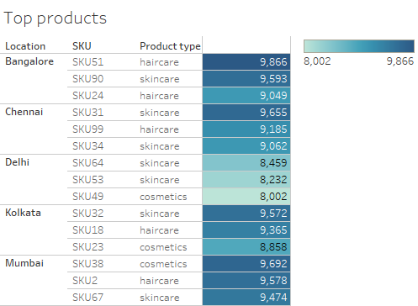
The following table shows the top products from each type for every location giving us a comprehensive summary of which products are performing the best in the market.

Slide 14
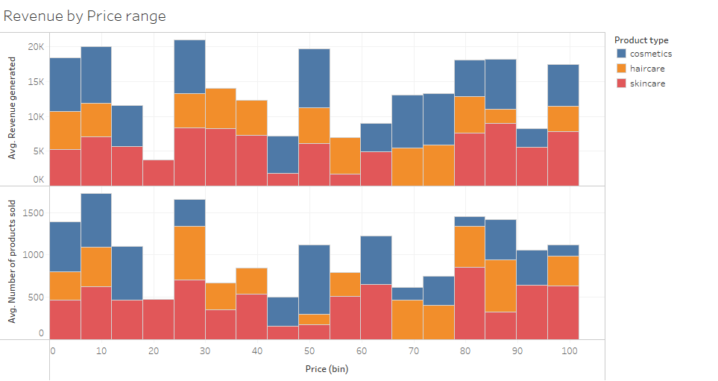
Products of what price range is doing good in the market. Which price range performance is concerning and needs attention?
We can observe smaller bars in the middle of the visual for skincare products, indicating that they are struggling in the market. Cosmetic products in the price range of 65-85 also show comparatively lower sales, while haircare products maintain consistent sales across all price ranges.

Slide 15
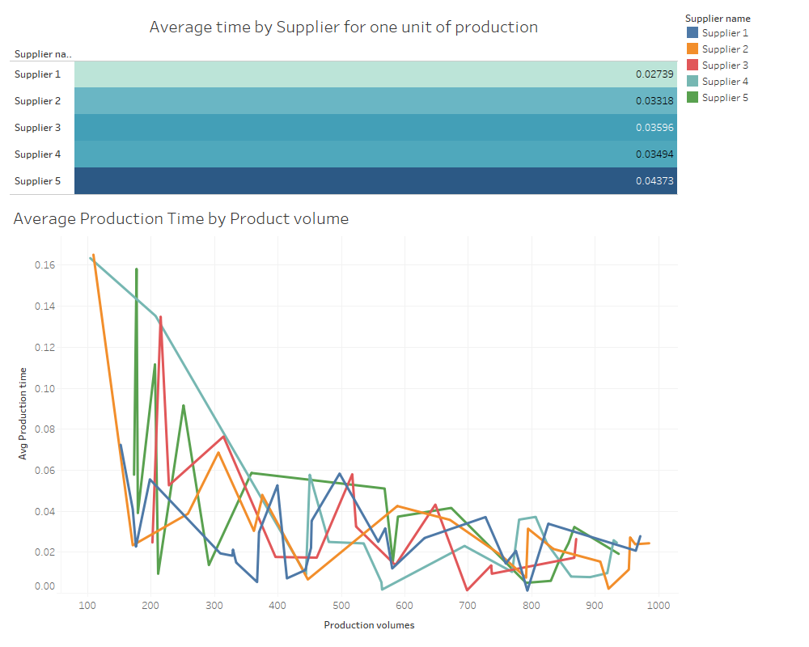
Which suppliers have the most efficient manufacturing process?

Slide 16
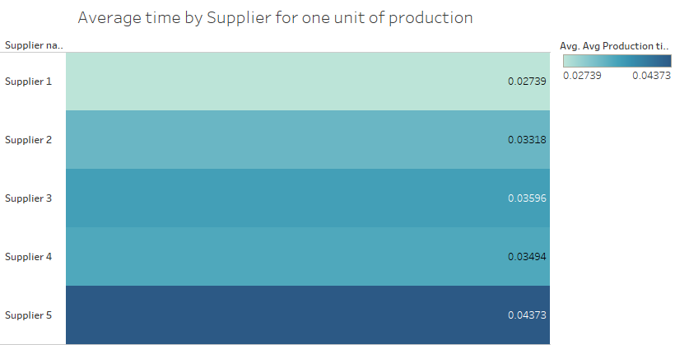
This visual illustrates that supplier 1 takes the least amount of time for one unit of production.

Slide 17
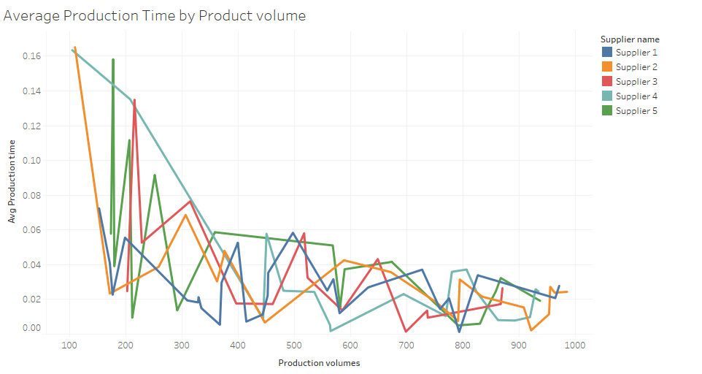
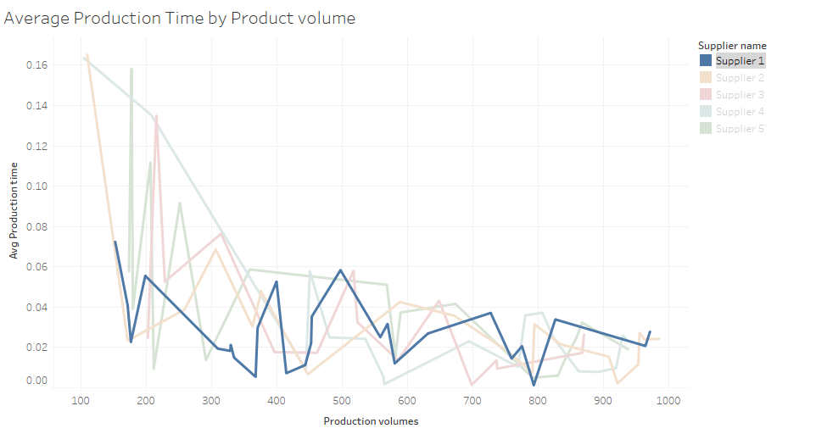
From the visual, we can observe that for all suppliers except Supplier 1, lower production volumes result in higher average times. However, as production volume increases, the average time decreases, and all suppliers tend to converge around a similar average. This suggests that manufacturers follow a uniform production approach, causing the average time to rise when the volume is lower (since Average time = Total time taken / Production volume).
In contrast, Supplier 1 maintains a consistent average across all production levels, resulting in a more efficient overall production time.

Slide 18
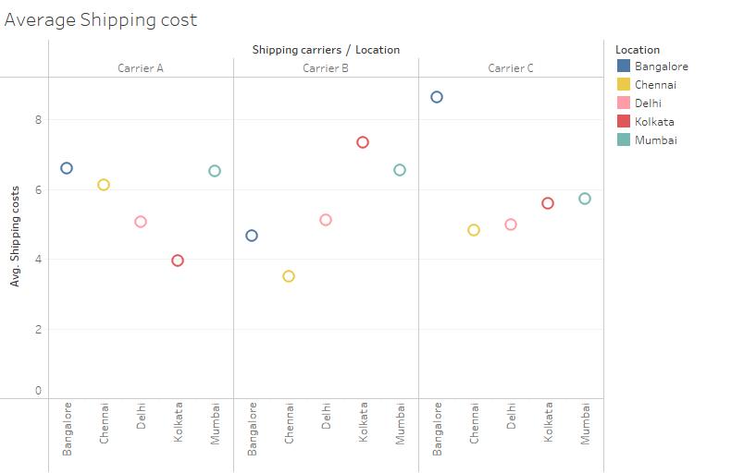
How do shipping costs vary by Shipping carriers and location?
From the following visual we can observe the average shipping cost of all the shipping carriers for different locations.
For carrier A the average shipping cost for Delhi and Kolkata is a little lower than the rest of the cities by carrier A.
For carrier B the average shipping costs for Kolkata and Mumbai is higher than the rest.
For carrier C the average cost for Bangalore is super high but consistent for the rest of the cities with the average cost between 4-6.

Slide 19
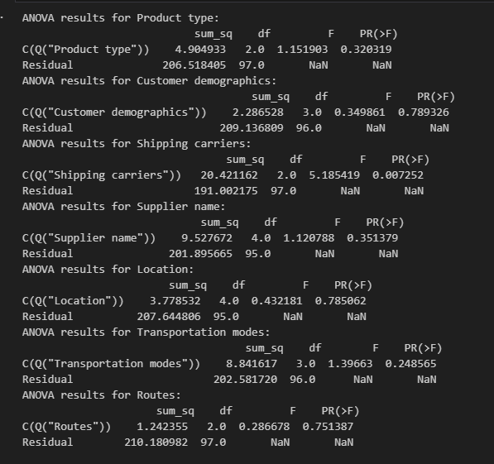
What are the significant factors affecting the Defect rates?
To answer this, we will use the statistical methods for the test of significance. We will use ANOVA test on the categorical features and regression analysis test for the continuous features.
Lets now look at the test results and its summary
ANOVA test Summary
The ANOVA test determines if two features are correlated. If the p-value is less than 0.05, we can conclude, with 95% confidence, that a correlation exists. In the output, the column "PR(>F)" represents the p-value for each feature. We observe that only "Shipping Carriers" (p-value = 0.007252) has a p-value below 0.05, indicating a significant correlation with product defect rates.
With this information, we can now create a targeted visual to explore this relationship further, without the need to generate visuals for every feature that lacks a significant correlation.

Slide 20
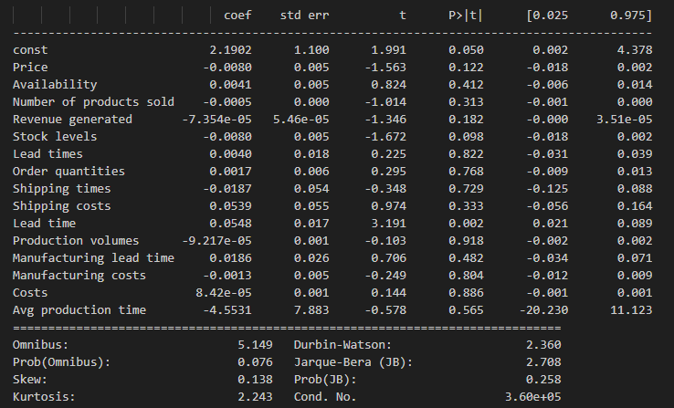
Similar to the ANOVA test, the p value determines if two features are correlated. Here the column P>|t| shows the p value.
We can see that only the feature Lead time(p value = 0.002) is significantly correlated to Defect rates.

Slide 21
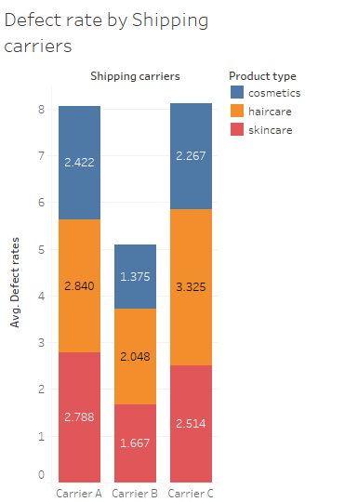
The bar graph clearly shows that the average defect rate is significantly higher for Carrier A and Carrier C compared to Carrier B, indicating that Carrier B handles products more effectively during shipping.

Slide 22
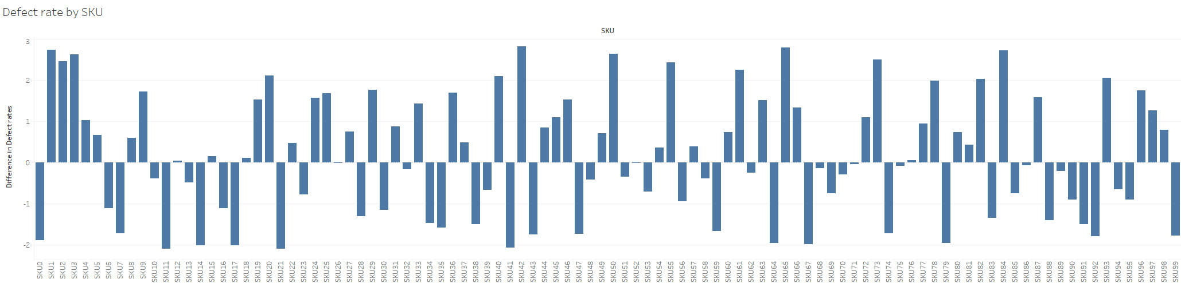
The following graph displays the deviation of defect rates for various SKUs from the median value, represented by the zero line. Bars extending above the zero line indicate SKUs with defect rates higher than the median, while bars below the zero line represent SKUs with lower defect rates.

Slide 23
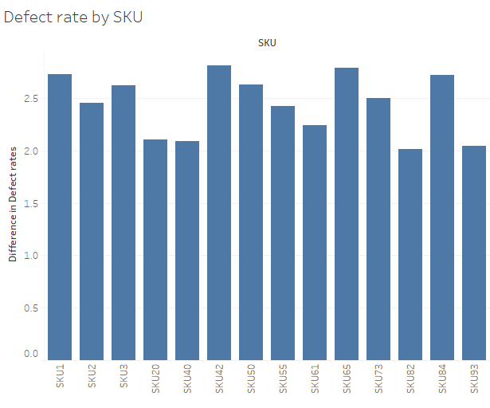
These products have defect rates more than 2 units above the median value, indicating significantly higher defect rates. With this information, we should closely examine these products to determine the underlying causes of the elevated defect rates. It’s important to assess whether the higher defect rates are due solely to the carrier or if other factors are contributing.

Slide 24
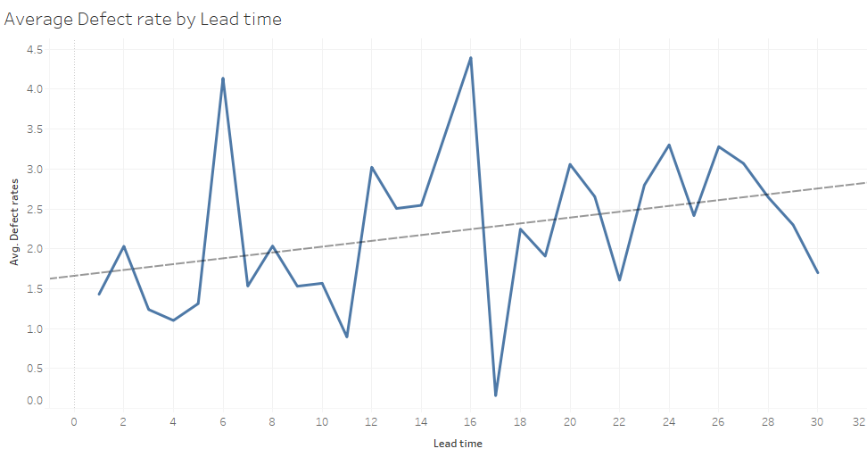
The following graph and the trend line shows that the Defect rate tends to increase when the Lead time increases. This suggests a positive correlation between Defect rates and Lead time.

Slide 25
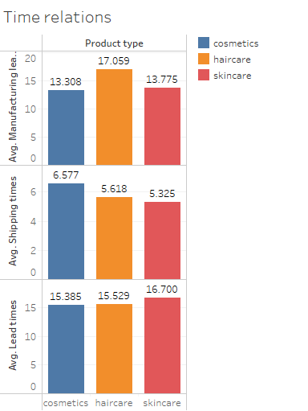
How does Product type affects the manufacturing, shipment and lead times?
For average manufacturing time, we observe that haircare products take longer to produce compared to the other product types. However, shipment and lead times are relatively consistent across all product types.

Slide 26
Conclusive Summary
After a thorough analysis, we now have a clear understanding of our business challenges and can focus on developing solutions to drive growth. To further increase profitability, we can implement the following strategies:
Reduce Defect Rates: Achieve this by selecting the most reliable shipping carriers.
Lower Shipping Costs: Optimize carrier selection based on location, while considering defect rate data to maintain quality.
Cut Manufacturing Costs: Decrease average production time by increasing batch sizes, ensuring we avoid overstocking.

Slide 27
Thank You
Presented by: Sanket Anand

